Slide 1

PAW PETROL
PET VOLUNTEER OPPORTUNITY

Slide 2
ARTIFICIAL INTELLIGENCE FOR BUSINESS DECISIONS AND TRANSFORMATION CSCN8030 Group: ASSIGNMENT: 1
Prashansa Rathod - 8993410
Harsh Joshi – 8952840
Jaiv Burman - 8930180
Nidhi Ahir – 9041129
Nil Kumar Patel - 8983991

Slide 3
PART:1 Animal Shelter Analytics Stakeholder Perspectives
Shelter Managers
Veterinarians
Adopters and Public

Slide 4



Donors and sponsors
Data Analysts and Developers

Slide 5
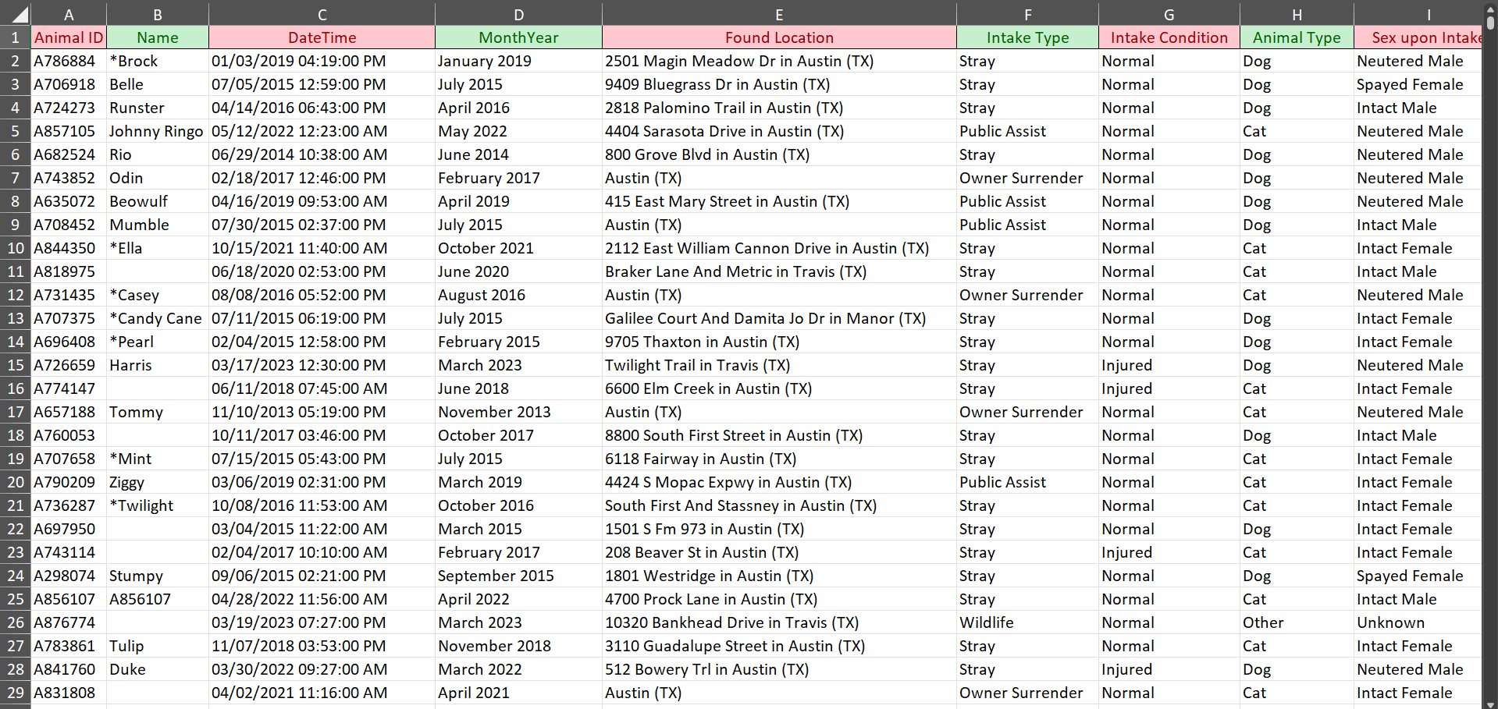
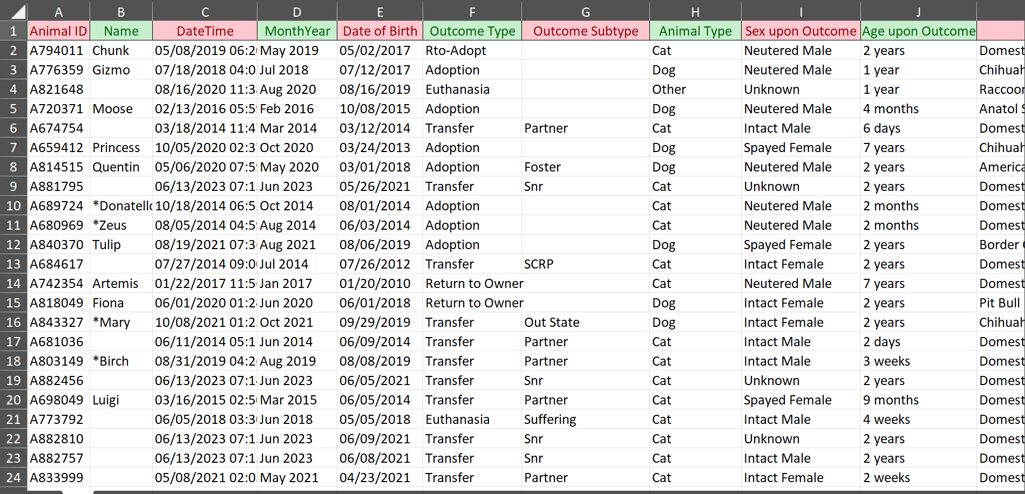
PART:2 Data Analysis and Visualization

Slide 6
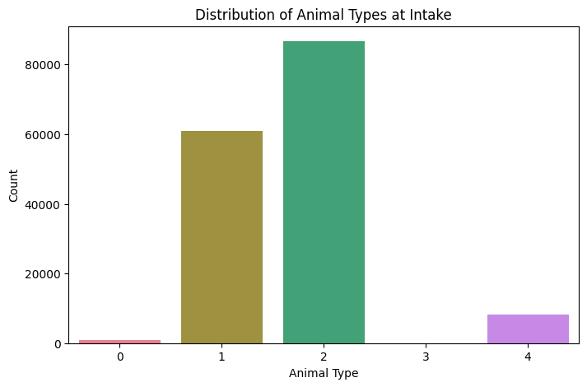
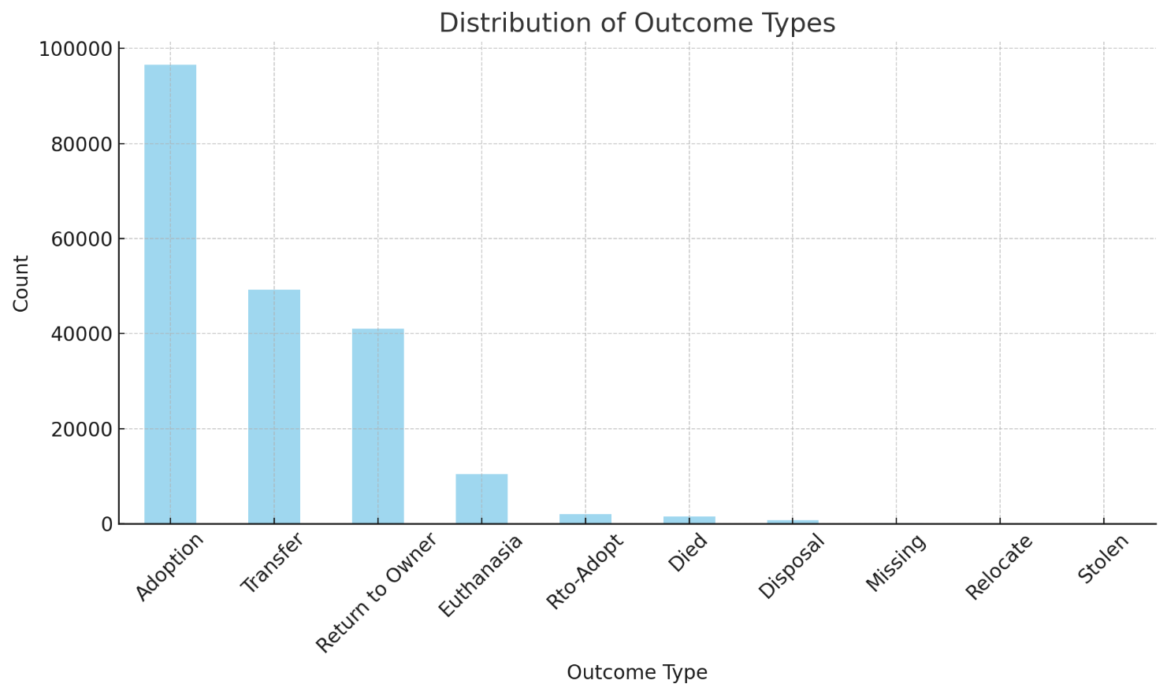
Dataset Distribution

Slide 7
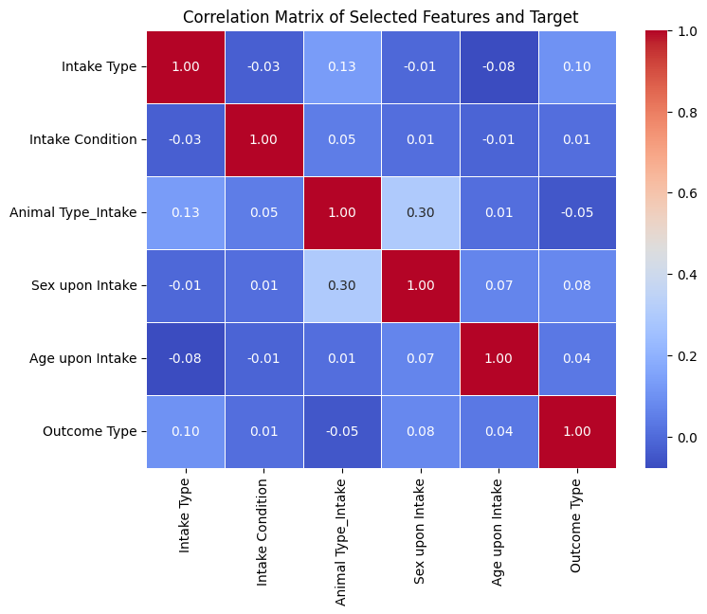
Correlation Matrix

Slide 8
Proposed DSS-Based Solutions
Outcome Prediction System:
Adoption Priority Dashboard:
Objective: Forecast the likely outcomes (adoption, transfer, etc.) for incoming animals.
Implementation: Use machine learning models to analyze historical data and predict outcomes based on attributes such as age, breed, and health condition.
Objective: Identify animals with lower adoption probabilities and prioritize their visibility to adopters.
Implementation: Create a dashboard highlighting animals at higher risk of prolonged stays or euthanasia.

Slide 9
Proposed DSS-Based Solutions
Seasonal Intake and Outcome Analysis:
Enhanced Animal Profile System:
Objective: Prepare shelters for seasonal trends in intakes and outcomes.
Implementation: Use time-series analysis to predict seasonal variations and align resources accordingly.
Objective: Increase adoption rates by providing detailed and visually appealing animal profiles.
Implementation: Use AI-powered tools to generate descriptive profiles, including photos and behavior summaries.

Slide 10
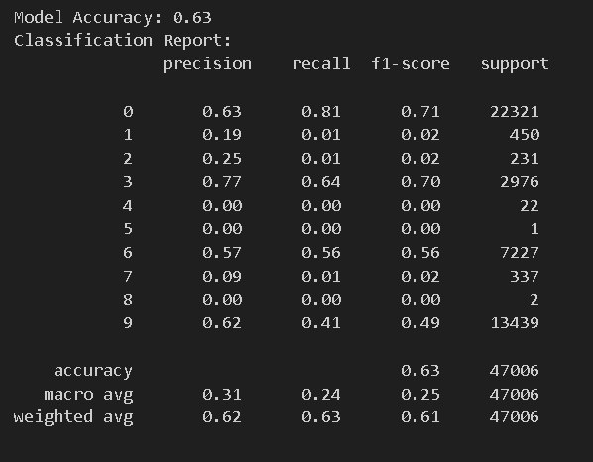
PART:3 Building a Simple AI Model
https://prashansarathod.github.io/CSCN8030AI/paw.html

Slide 11
PART:4 DSS Implementation Strategy
Technical Considerations
To implement the Decision Support System (DSS) effectively:
Required Tools: Python-based frameworks (e.g., Scikit-learn, Pandas) for model development and data preprocessing. Use cloud services like AWS or Azure for scalability and storage.
Data Pipeline: Establish ETL (Extract, Transform, Load) processes to clean, integrate, and standardize data from multiple sources (e.g., intake and outcome datasets). Automate data updates to ensure real-time insights.
Model Integration: Use RESTful APIs to embed the AI model into existing shelter management software, enabling seamless access to predictions.
Operational Considerations
Deployment: Deploy the DSS on a cloud-based platform for ease of access across multiple shelter locations.
Training for Users: Conduct training sessions for shelter staff on using the DSS interface, interpreting predictions, and leveraging insights for decision-making.
Scalability: Design the system to handle increased data volumes and additional features, such as advanced predictive analytics and multi-shelter integration.

Slide 12
PART:4 DSS Implementation Strategy
Financial Considerations
Cost of Implementation: Estimated cost of $15,000–$20,000 for initial development, cloud deployment, and staff training.
Potential Savings/Benefits: Improved resource allocation could reduce shelter operation costs by 20%. Higher adoption rates would result in cost savings on animal care and increased donor satisfaction, boosting funding opportunities.

Slide 13
Thank you

